Slide 1

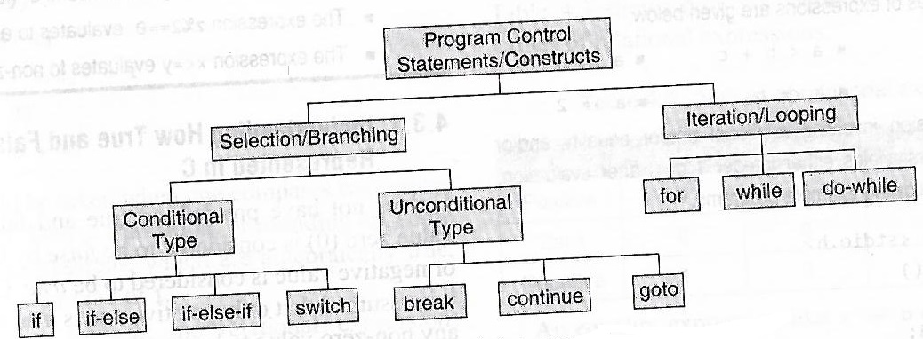
Programming in c
Decision Making & Branching…
By default, C program Executes sequentially. The order of execution can be changed by using if, switch, conditional operator ,goto statements.
They are popularly known as decision-making statements.
As these statements control flow of execution, also known as control statements.

Slide 2
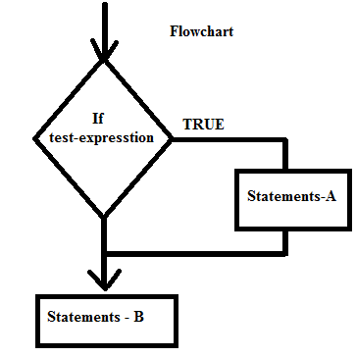
Programming in c
Simple if statement…
It is two-way decision statement
Algorithm / Pseudocode
IF test-expression is true, THEN Execute - statements-A
2. Execute - statements-B
syntax
If ( test_expresssion)
{
statements - A;
}
statements – B ;
If ( test_expresssion)
statement – 1 ;
statements – 2 ;
Example s:
if ( a == 0)
{
printf(“division by zero”);
exit (0);
}
ans = b * c / a
If ( a < 0)
a = -1 * a ; // get absolute value
ans = sqrt (a) * 1.5 ;

Slide 3
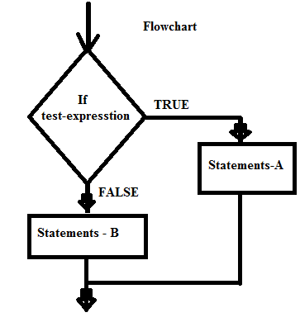
Programming in c
If - else statement…
It is two-way decision statement, any one of the block is executed
Algorithm / Pseudocode
IF test-expression is true,
THEN Execute - statements-A
ELSE Execute - statements-B
syntax
if ( test_expresssion)
{
statements - A;
}
else
{
statements – B ;
}
If ( test_expresssion)
statement – 1 ;
else
statements – 2 ;
Examples
if ( age <= 18)
printf(“Not Eligible toVote”);
else
{
printf(“EligibileToVote”);
count ++;
}
If( n % 2 == 0) printf(“EVEN”);
else printf(“ODD”);

Slide 4
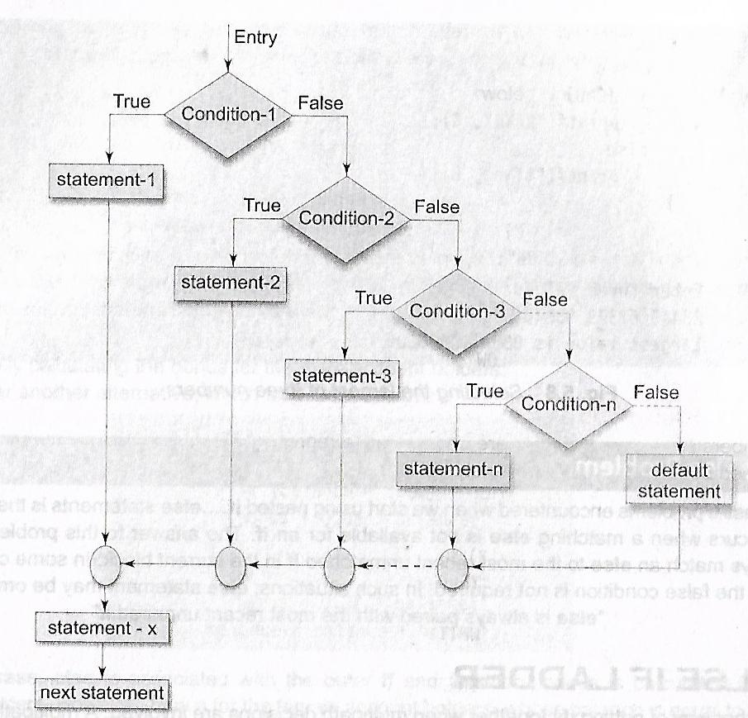
Programming in c
Simple else - if / else-if ladder statement…
It is Multi-way decision statement
syntax
If ( condition1)
statement1;
else if (condition2)
statement2;
else if (condition3)
statement3;
else
statement4;
Example:
if(marks >=75)
printf(“Distinction”);
else if (marks > =60)
printf(“FirstClass”);
else if (marks >=40)
printf(“Pass”);
else
printf(“Fail”);

Slide 5
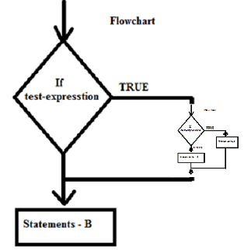
Programming in c
Nested if-else statements…
Embedding if-else in another if-else statements.
syntax
If ( condition1)
if ( sub-conditon1)
statement 1;
else
statement 2;
else
statement3;
Example:
if(marks >=40)
if (attendence >70)
printf(“PASS”);
else
printf(“NSAR”);
else
printf(“NSSR”);

Slide 6
Programming in c
A bank has taken decision to give bonus of 2 % of the balance is given to all account holders irrespective of their balance, and 5% is given to female account holders if their balance is more than 5000.Calculate new balance
char sex ;
int bal, bonus =0;
printf( “Enter Balance & Sex\n”);
scanf(“%d %c”,&bal,&sex);
if( sex == ‘F’ )
if (bal > 5000)
bonus = bal * 0,05 ;
else
bonus = bal * 0.02;
else
bonus = bal * 0.02;
bal = bal + bonus;
printf( “ bal = %d\n”,bal);

Slide 7
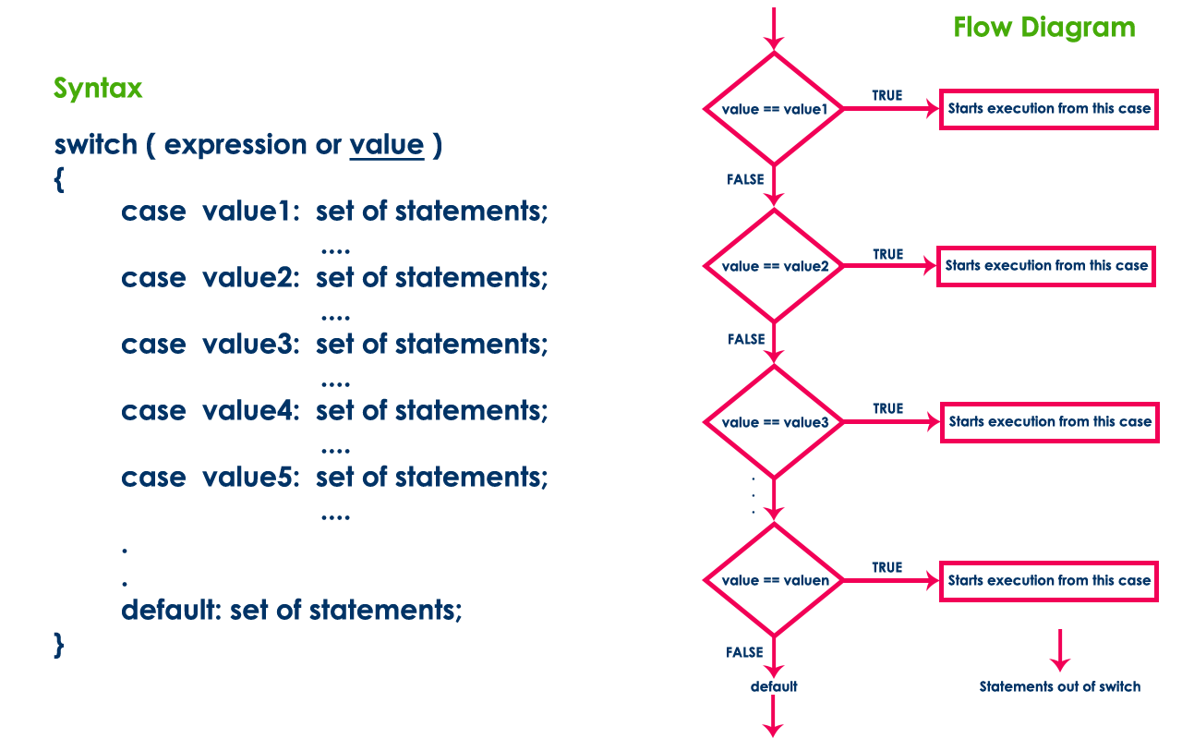
Programming in c
The switch statement is a multiway branch statement ;Switch statement in C language is used to solve multiple option type problems for menu like program, where one value is associated with each option
Example
#include <stdio.h>
int main()
{
int x = 2;
switch (x)
{
case 1: printf("Choice is 1");
break;
case 2: printf("Choice is 2");
break;
case 3: printf("Choice is 3");
break;
default: printf(“OtherChoice ");
break;
}
return 0;
}
Switch case statements are a substitute for long if statements that compare a variable to several integral values. The default statement is optional

Slide 8
Write a program to determine whether the character
entered is an upper case letter, lower case letter,
digit or a special character.
#include <stdio.h>
#include <conio.h>
void main()
{
char ch;
printf("Enter a character\n");
scanf("%c",&ch);
if (ch>=65 && ch<=90)
printf("Upper Case Letter\n");
else if(ch>=97 && ch<=122)
printf("Lower Case Letter\n");
else if (ch>=48 && ch<=57)
printf("Digit\n");
else
printf("Special character\n");
}
Output:
Enter a character
9
Digit

Slide 9
Programming in c
Working of switch statement :
The expression provided in the switch should result in a constant value otherwise it would not be valid. Valid expressions for switch:
// Constant expressions allowed switch(1+2+23) switch(1*2+3%4)
Invalid switch expressions for switch:
// Variable expression not allowed switch(ab+cd) switch(a+b+c)
Duplicate case values are not allowed.
The default statement is optional. Even if the switch case statement do not have a default statement, it would run without any problem.
The break statement is used inside the switch to terminate a statement sequence. When a break statement is reached, the switch terminates, and the flow of control jumps to the next line following the switch statement. The break statement is optional. If omitted, execution will continue on into the next case. The flow of control will fall through to subsequent cases until a break is reached.
Nesting of switch statements are allowed, which means you can have switch statements inside another switch. However nested switch statements should be avoided as it makes program more complex and less readable.

Slide 10
Program to evaluate simple arithmetic expression
int main()
{
int a,b; char choice;
printf(“Enter: Operand1 Operator Operand2\n”);
scanf("%d %c %d",&a,&choice,&b);
switch(choice)
{
case '+': printf("%d + %d = %d",a,b,a+b);
break;
case '-': printf("%d - %d = %d",a,b,a-b);
break;
case '*': printf("%d * %d = %d",a,b,a*b);
break;
case '/':
if(b!=0)
printf("%d / %d = %d",a,b,a/b);
else
printf("divide by zero\n");
break;
default :break;
}
return 0;
}
Program Result
Input:
4 + 5
Output:
4 + 5 = 9

Slide 11
Menu Program for calculator
#include <stdio.h>
int main()
{
int a,b,choice;
printf("EnterA&B:");scanf("%d%d",&a,&b);
printf("1.Add\n2.Sub\n3.Mul\n4.Div\n5.Exit\n");
scanf("%d",&choice);
switch(choice)
{
case 1: printf("%d + %d = %d",a,b,a+b);
break;
case 2: printf("%d - %d = %d",a,b,a-b);
break;
case 3: printf("%d * %d = %d",a,b,a*b);
break;
case 4 :printf("%d / %d = %d",a,b,a/b);
break;
default :break;
}
}
Program Result
Input:
EnterA&B: 4 5
1.Add
2.Sub
3.Mul
4.Div
5.Exit
1
Output:
4 + 5 = 9

Slide 12
Program to check the validity of a triangle, if sides are given
Property of triangle
A triangle is valid if sum of its two sides is greater than the third side. Means if a, b, c are three sides of a triangle. Then the triangle is valid if all three conditions are satisfied a + b > c a + c > b and b + c > a
Algorithm :
Input sides of a triangle from user. Store them in
some variable say side1, side2 and side1.
2. Given triangle is valid if side1 + side2 > side3
and side1 + side3 > side2 and side2 + side3 > side1.
3. If it is valid, then Identify the type of triangle.
Check if(side1 == side2 && side2 == side3),
then the triangle is equilateral.
If not, Check if(side1 == side2 || side1 == side3 || side2 == side3), then triangle is isosceles.
If not, then it scalene triangle.
#include <stdio.h>
int main()
{
int side1, side2, side3;
printf("Enter three sides of triangle: \n");
scanf("%d%d%d", &side1, &side2, &side3);
If ((side1 + side2 > side3) && (side1 + side3 > side2) && (side2 + side3 > side1))
{
printf("Triangle is valid.");
if(side1 == side2 && side2 == side3)
printf("Equilateral triangle.");
else if(side1 == side2 || side1 == side3 || side2 == side3)
printf("Isosceles triangle.");
else
printf("Scalene triangle.");
}
else
printf("Triangle is not valid.");
return 0;
}
Copyright (C) 2019 , Prof.BadariNath.K

Slide 13

/* C program to compute diameter,
circumference and area of a circle */
#include <stdio.h>
int main()
{
float radius, diameter, circumference, area;
printf("Enter radius of circle: ");
scanf("%f", &radius);
diameter = 2 * radius;
circumference = 2 * 3.14 * radius;
area = 3.14 * (radius * radius);
printf("Diameter of circle = %.2f units \n", diameter);
printf("Circumference of circle = %.2f units \n", circumference);
printf("Area of circle = %.2f sq. units ", area);
return 0;
}
/*C program to find all angles of a triangle if two angles are given */
#include <stdio.h>
int main()
{
int a, b, c;
printf("Enter two angles of triangle: ");
scanf("%d%d", &a, &b);
c = 180 - (a + b);
printf("Third angle of the triangle = %d", c);
return 0;
}
/*C program to convert temp to fahrenheit*/
#include <stdio.h>
int main()
{
float celsius, fahrenheit;
printf("Enter temperature in Celsius: ");
scanf("%f", &celsius);
fahrenheit = (celsius * 9 / 5) + 32;
printf("%.2f Celsius = %.2f Fahrenheit", celsius, fahrenheit); return 0;
}
/*
C program to find whether a given year is leap year or not
*/
void main()
{
int year;
printf("Enter a year \n");
scanf("%d", &year);
if ((year % 400) == 0)
printf("%d is a leap year \n", year);
else if ((year % 100) == 0)
printf("%d is a not leap year \n", year);
else if ((year % 4) == 0)
printf("%d is a leap year \n", year);
else
rintf("%d is not a leap year \n", year);
}
Copyright (C) 2019 , Prof.BadariNath.K

Slide 14
Program to swap two numbers
void main()
{
int num1, num2, temp;
printf("\nEnter two numbers:");
scanf("%d %d", &num1, &num2);
printf("\nThe numbers before swapping are Number1= %d Number2 = %d", num1, num2);
temp = y ;
y = x;
x = temp;
printf("\nThe numbers after swapping are Number1= %d Number2 = %d", num1, num2);
}
Program to swap two numbers, with using bit wise operator, not using any temporary variable
void main()
{
int num1, num2;
printf("\nEnter two numbers:");
scanf("%d %d", &num1, &num2);
x = x ^ y;
y = x ^ y;
x = x ^ y;
printf("\nThe numbers after swapping are Number1= %d Number2 = %d", num1, num2);
}

